Slide 1



Project ECHOTM and our CHW/CHR Initiatives
EXTENSION FOR COMMUNITY HEALTHCARE OUTCOMES
Dr. Kathleen Colleran, MD
Director, Diabetes and
Cardiovascular Risk Reduction ECHO Programs
UNM Health Sciences Center
WORKING TO BRING SPECIALTY HEALTHCARE TO ALL PEOPLE

Slide 2
EXTENSION FOR COMMUNITY HEALTHCARE OUTCOMES
The mission of Project ECHOTM is to develop the capacity to safely and effectively treat chronic, common and complex diseases in rural and underserved areas and to monitor outcomes.
Supported by Agency for Health Research and Quality HIT grant 1 UC1 HS015135-04, and MRISP, R24HS16510-02 and the New Mexico Legislature, Robert Wood Johnson Foundation.
WORKING TO BRING SPECIALTY HEALTHCARE TO ALL PEOPLE

Slide 3
Project ECHO Methods
  Train rural and underserved physicians, nurses, pharmacists, educators in diagnosis and treatment of common, complex and treatable diseases
  Use IT to leverage resources
    Telemedicine “clinics”
      CME/CE- didactics
      Case based learning- by rural participants
      Multidisciplinary team sharing
      Patient co-management

Slide 4
Project ECHO Benefits
  Patients receive specialty care while remaining in their communities
    Medical home model
    Patient centered care
  Participants learn new skills and knowledge
    Earn CME/CE credit
  Provider isolation is diminished
    hopefully increasing retention
  Wait time for treatment is improved
  $$$$$ savings

Slide 5
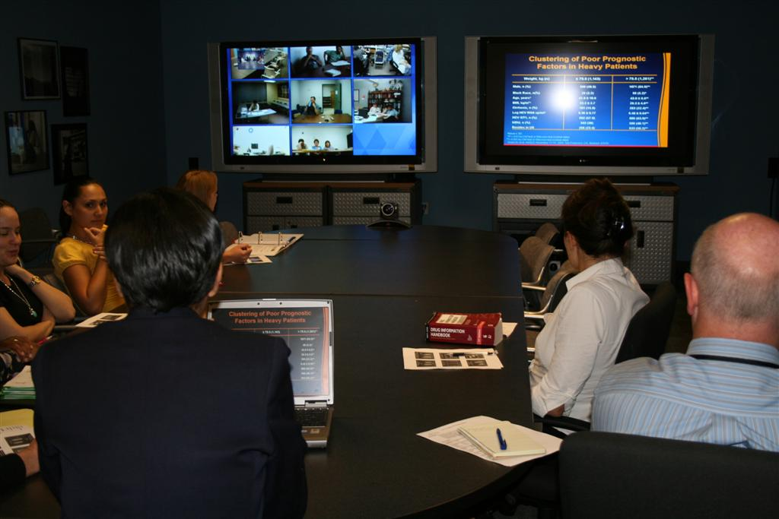

Slide 6
How well has model worked?
>700 HCV Telehealth Clinics have been conducted
>7,000 case presentations
>700 patients have been treated
>7,000 CME/CE hrs issued at no-cost
>500 hours of HCV training conducted at rural sites
Provider Satisfaction
  New knowledge
  Self Efficacy
  Decreased Isolation
  Collegiality/Collaboration

Slide 7
Success
Highly successful in improving HCV care in NM
  Safe and effective
Expansion to other areas
  Rheumatology Diabetes/CVD risk reduction
  HIV Childhood obesity
  Asthma Occupational Health
  Substance Abuse High risk OB
  Behavioral health Pain

Slide 8

Working to bring specialty healthcare to all people

Slide 9
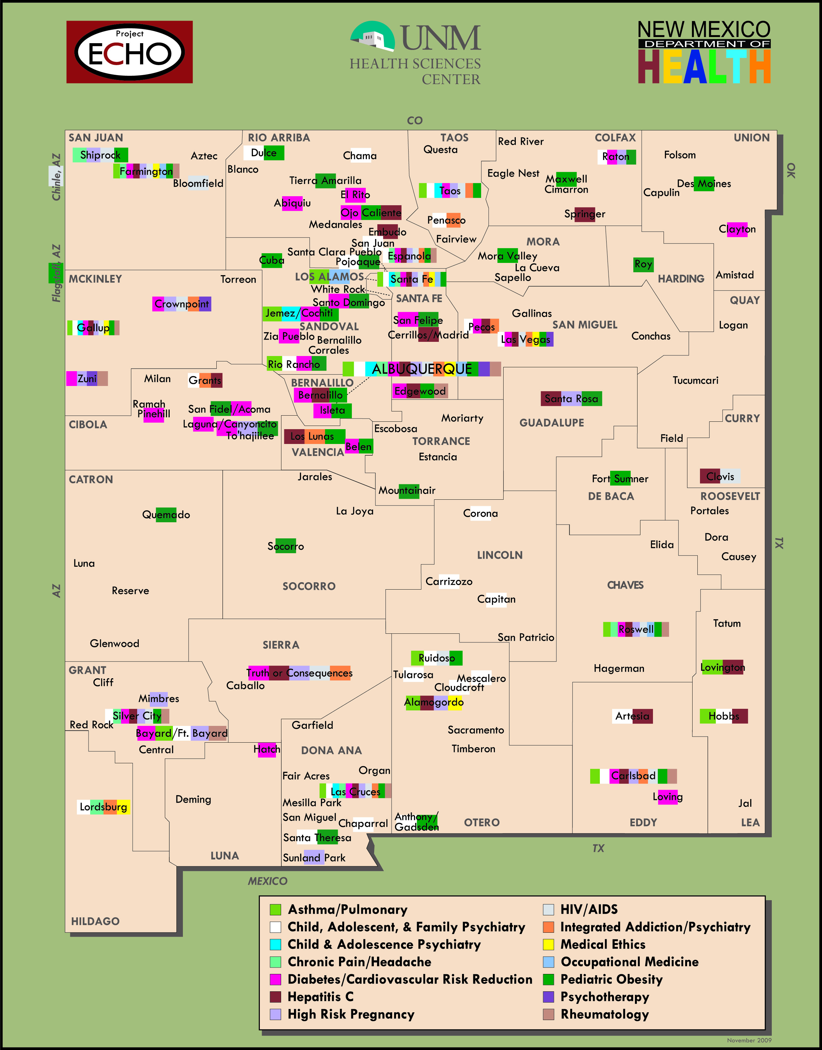

Slide 10
24x106 2008
20.8x106 2006
Diabetes Mellitus in the US
18,000,000
16
14
12
10
8
IGT
Persons With Diagnosed Diabetes (millions)
6
4
2
0
1958
1968
1978
1988
1998
2004
Year
Diabetes Overview. October 1995 (updated 1996). NIDDK publication NIH 96-1468.
Kenny SJ et al. In: Diabetes in America. 2nd ed. 1995:47-67.
Notes:
10

Slide 11
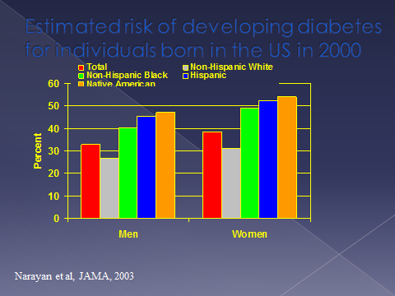

Slide 12
Control of CVD Risk Factors

Slide 13
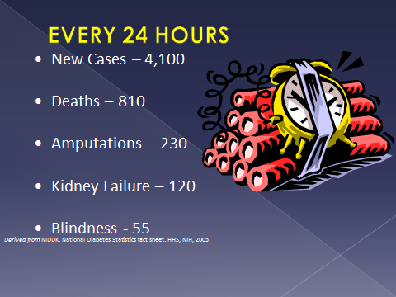

Slide 14
More Bad News
Childhood overweight (18%)
  Metabolic derangements more detrimental
  Greatest increase in diabetes incidence
Diabetes in pregnancy
  75% increase in DM in pregnancy (preexisting DM 2)
  ??? Negative metabolic imprinting effects on the offspring
The Recession/Depression
  Obesity/malnutrion

Slide 15
The Health Care Disaster
More Disease
  Increased disability (Social Security)
Increased Expenses
Decreased Longevity
  Decreased work force (Social security)

Slide 16
As a result of the obesity epidemic for the first time in recorded history, children of the current generation will likely have a shorter life span than their parents.

Slide 17
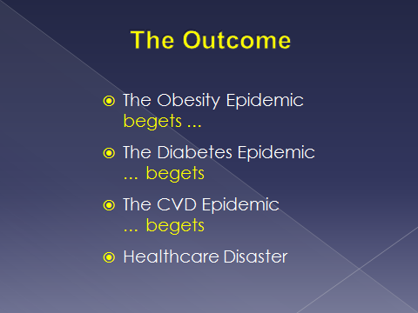

Slide 18
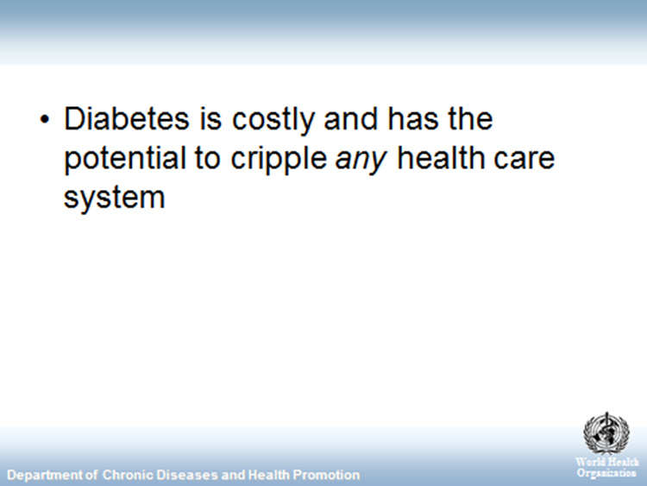

Slide 19
Diabetes and the ECHO Model
“Quotes from my travels”
  Its just diabetes: its not like HCV where they can DIE
  We want to focus on HIV, Rheumatology, areas we
  can impact
  It’s the health educators that need training
  They just won’t do what I tell them to do
  I have done all I can

Slide 20
Which of the following statements about poor diabetes outcomes is true?
It’s genetic
It’s the patients fault
It’s the families fault
It’s the doctors fault
It’s the health care systems fault
It’s the government’s fault
It’s the dogs fault

Slide 21
Summary of the Problem
Diabetes is a common, complex, chronic, multifactorial, multifaceted disease
It is not sexy; It can be exhausting
Provider Burnout and Clinical Inertia are high
It has never received the respect it deserves
It requires a complex, chronic, multifactorial and multifaceted treatment
It takes a village to properly treat diabetes

Slide 22
Who needs to be on the diabetes team?
Patient/Family
Community
Provider
RN
Community Health Worker/ Promotora/CHR
CDE
Pharmacist
Dentist/Optometrist
The dog

Slide 23
Paraprofessional Health Care Workers
Lay health care workers have been recognized since 1950s.
Initially utilized in migrant farming communities
Expansion to indigenous communities
>12,500 CHWs practicing in US

Slide 24
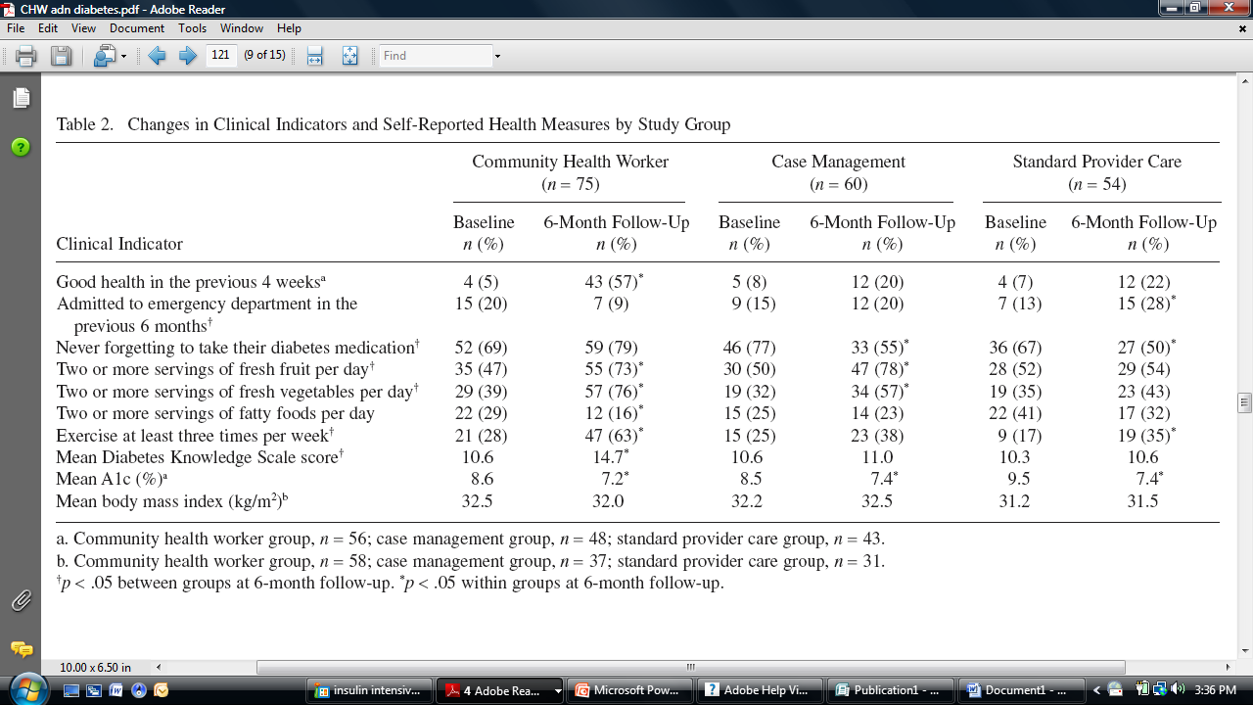

Slide 25
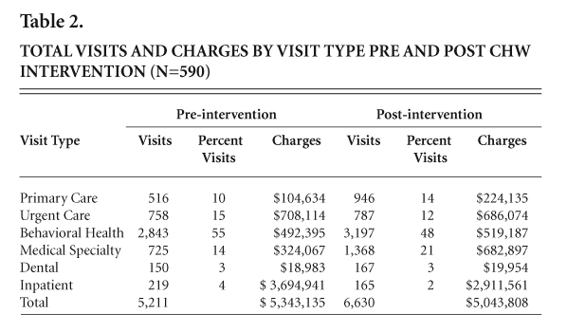
Cost Effective Data

Slide 26
Show movie

Slide 27
ECHO and CHWs/CHRs for Diabetes
Phase 1 Training
  6-month ECHO based distance learning diabetes curriculum
    Didactics
    Case based
    Culturally adapted
Phase 2 Implementation into Practices
  Pilot the Teamlet model using CHWs as the coach
  On going support through ECHO
Phase 3 Sustainability
  Evaluation of health care organizations
  Billing/Reimbursement

Slide 28
ECHO Diabetes
Community Resource Education Worker Training (CREW)
There are MANY effective
CHW/CHR training programs, and many studies demonstrating the effectiveness of CHWs/CHRs as chronic disease managers (especially in diabetes).
What is DIFFERENT about our model?

Slide 29
What is the ECHO CHW training model?
No cost to participants (no tuition, travel reimbursement, free IT support)
Three modes of delivery:
  Face-to-face training, allowing for hands-on training and practice of skills
  Weekly teleconferences (with participants on both video and phone), which include
    presenting and discussing patient cases
    resource sharing, networking and strategic didactic presentations by experts
    participant learning loops
  3. Video modules for material that doesn’t require much interactive Q & A

Slide 30
NOT a train-the-trainer model
We are NOT training for a specific intervention protocol. Rather, we have created a highly rigorous training with broad applicability.
This allows these diabetes-specialists to serve within a wide variety of contexts (clinics, diabetes or heart-health programs, home visits, elder-care or assisted living centers, etc.), perform a wide variety of roles, and move within roles in their employment and improve their employment opportunities.

Slide 31
More sustainable for CHW, employer and training organization
“Light-footprint” training modality, using ECHO principles such as technology to overcome barriers and maintain low cost.
Does not require participants to leave their communities, families or jobs for an extensive training periods.
Emphasis on team approach.
Highly replicable and sustainable across the globe.
Ongoing participation in the sessions after completion of training.

Slide 32
This isn’t “one and done”
Quality-assurance and ongoing learning provided by weekly teleconferences during and following training period.
We provide basic certification and added “endorsements” in specific skills they have mastered.

Slide 33
We are also training supervisors for systems-level change
We are reaching beyond the CHW/R participants to clinic administrators and supervisors.
We aim to improve and support CHW/ R integration into the chronic care team by:
  teaching sustainable billing and scheduling options
    group visits
    warm handoff
  demonstrating the benefit of using rigorously trained CHW/Rs to their full potential.

Slide 34
We are in for the long term
This allows us to be responsive the needs and interests of our trainees, and we have adapted our training model accordingly.
In response to participant requests, we have increased the rigor of our trainings and now do extensive skills training and evaluation:
    Skills taught in 30-minute small group (2-3 individuals) stations, with emphasis on “see it, do it (over and over) and teach it.”
    Pre/post-testing adapted from clinical evaluation of medical students, with one-on-one patient interaction scenarios and check-lists.

Slide 35
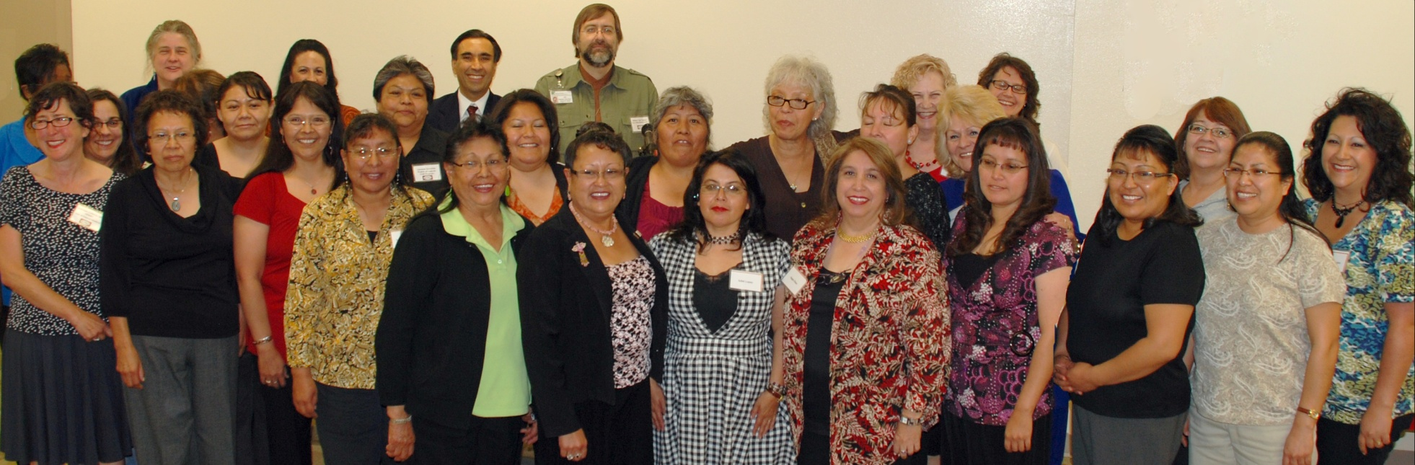
CHWs are an important part of the answer…

Slide 36
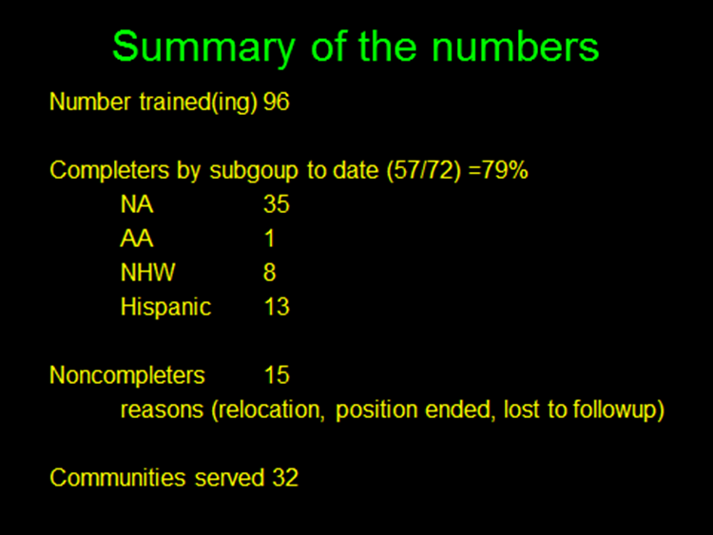

Slide 37
ECHO Diabetes-Specialist Training Results
Cohort 1: Pre/post Survey Results
Participants completed three pre/post surveys: the Michigan Diabetes Research and Training Center (MDRTC) Diabetes Attitude Survey (DAS); a Diabetes Knowledge Test (mDKT), a modified version of the MDRTC Diabetes Knowledge Test; and a Diabetes Confidence Survey (DCS), divided into clinical and non-clinical subsets.
 | Baseline | Completion of 6-month training | Significance (p-value)
mDKT % correct | 57 | 71 | 0.0002
DCS CS (scale 1-5) | 3.30 | 4.40 | 0.0001
DCS NCS (scale 1-5) | 3.62 | 4.29 | 0.0002
DAS (scale 1-5) | 4.10 | 4.39 | .04
Notes:
Put in number of participants

Slide 38
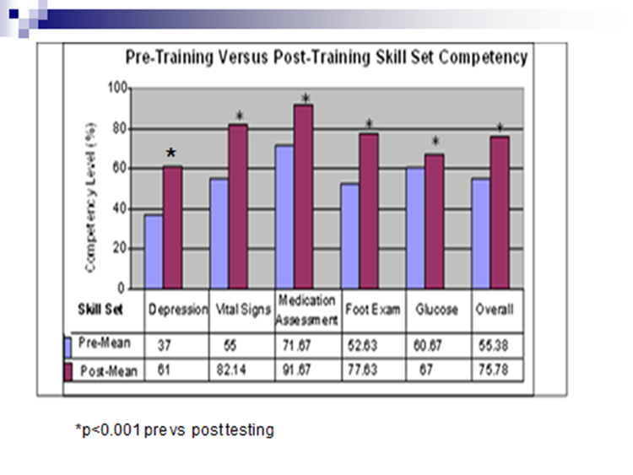

Slide 39
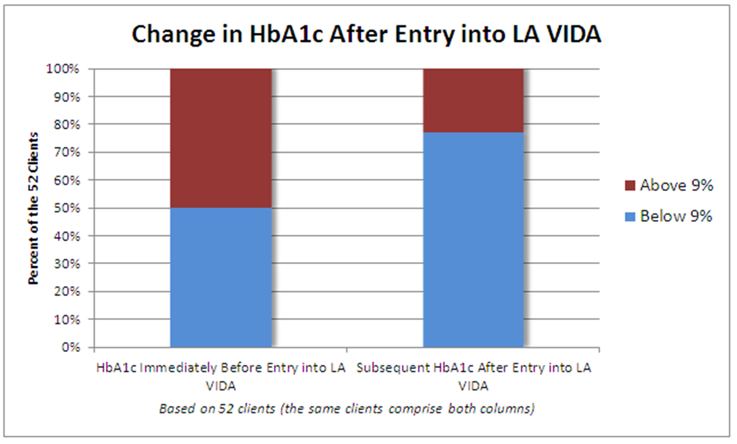
Data from HMS-CHW program

Slide 40
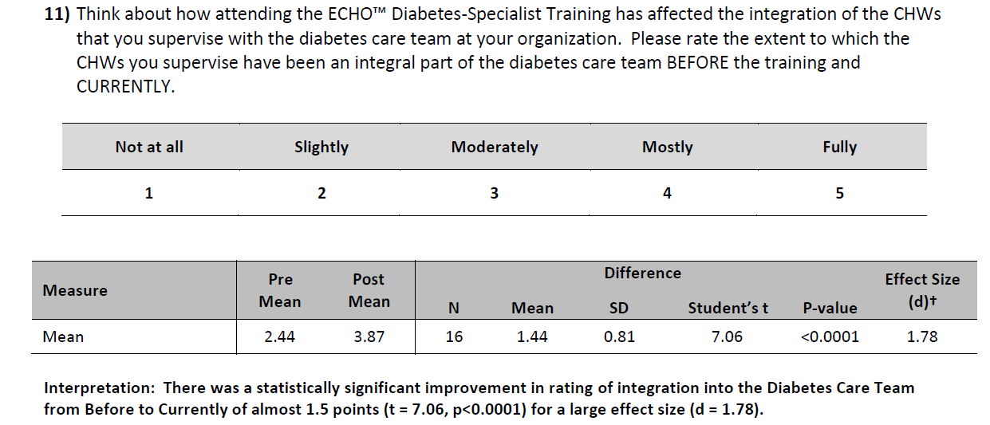
Integration into the Team
CHW Supervisors: Results from survey analysis

Slide 41
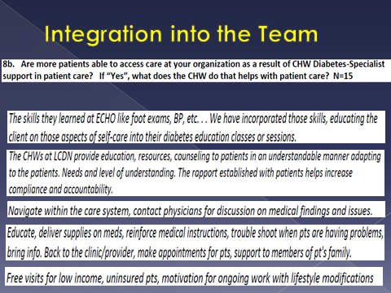

Slide 42
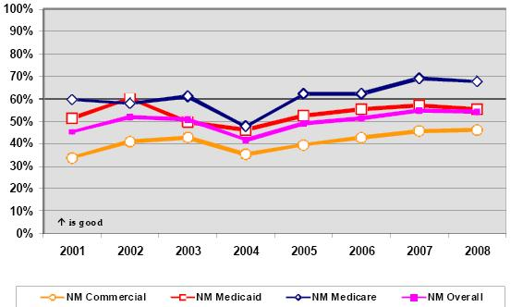
Adherence to Retinal Screening Guidelines
NM HEDIS Data: Trends for dilated eye exam rates 2001 - 2008
Notes:
New Mexico Health Care Takes on Diabetes. New Mexico Diabetes Indicators Baseline and Remeasurement Report 2001-2008
http://nmtod.com/pdfs/hedis.pdf

Slide 43
The ECHO/VisionQuest Collaboration
What ECHO provides
* liaison with community partners
* training for CHWs (imaging, DM specialist training)
* training for clinics and teams (including CME)
* scheduling and facilitation
* free consultation and access to specialist team for patient management
What VQ provides
* 2 retinal cameras and all necessary equipment and technology
* certified readers and timely reports
* training and ongoing technical support
* IRB and research paperwork

Slide 44
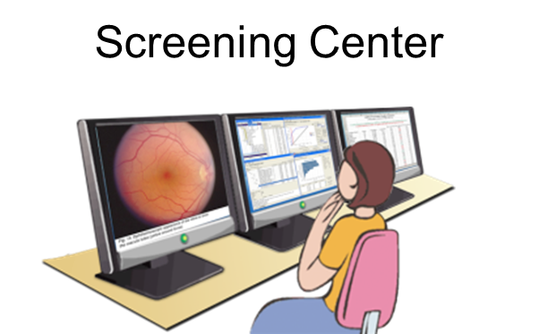

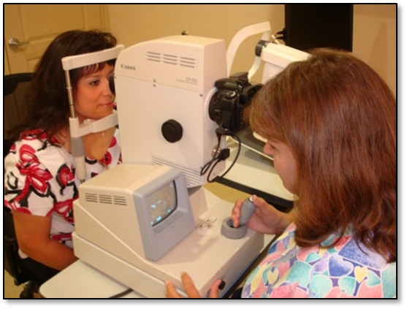


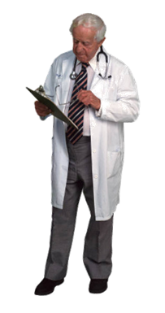

ECHO-Visionquest
Retinopathy Screening
Patient
CHW is doing the imaging
Reports with results get sent back to medical point-of-contact
Notes:
What is one of our current challenges to meet this need? Diabetic retinopathy screening process. Currently, in order to get examined for diabetic retinopathy, you have to go to an eye doctor. Well, a lot of you are from some far out areas and the closest eye doctor is a few hours away. Well this our retinal screening solution… To identify if Diabetic Retinopathy is present, we first acquire retinal images. The patient sits in front of a retinal imaging camera and several pictures are taken. The images are then uploaded to the internet, via complete HIPAA compliant and FDA cleared internet database, to our optometrists in Albuquerque to grade. The optometrists grades the images and the results are sent back to the clinic for review with the patient.

Slide 45
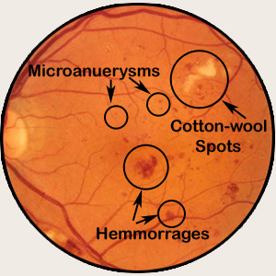
Notes:
Microanuerysms are where the capillary wall bulges out
Hemomorrhages are where the capillaries leak blood
Cotton wool spots are areas where the nerves are damaged

Slide 46
Retinal Screening program to date
Total screened |  | 1016
With DM |  | 41%
No finding |  | 548 | 54%
Inadequates |  | 162 | 16%
Findings |  | 306 | 30%

Slide 47
Retinal Screening program: Breakdown of Findings by Level of Urgency
Total findings |  | 306 | 30%
Level A (Emergent) |  | 21 | 2%
Level B (3-4 months) |  | 87 | 9%
Level C (6 months) |  | 102 | 10%
Level D (1 year referral) |  | 96 | 9%

Slide 48
How the ECHO/VQ screening program works
Results of screening and recommendations sent back to clinic
CHW takes and uploads retinal image
Image is read by optometrist in Albuquerque
Clinic provider or representative re-presents case for follow up as needed
ECHO provides recommendations for diabetes treatment that are faxed to provider
Clinic provider or representative may want to present case to ECHO Diabetes team
Notes:
Case presentation template is included in provider packet

Slide 49
Conclusions
Diabetes and diabetic complications are on the rise, likely to cripple the health care system
Interventions are available to prevent DM and DM complications
Interventions are underutilized
New models of health care delivery are needed to address unmet needs
CHW/CHRs will be instrumental in the adaption of the medical home model/patient centered care/health care reform

Slide 50
Diabetes related ECHO initiatives
DM and Cardiac Care Clinic
Childhood Obesity Medical Management Tele-health Clinic (COMM-TC)
Community Health worker program Community Resource Education Worker (CREW) Training Program
Retinal Screening program- in partnership with Vision Quest

Slide 51
Show movie

Slide 52

EXTENSION FOR COMMUNITY HEALTHCARE OUTCOMES
For more information contact:
Kathleen Colleran, MD
Medical Director, ECHO Diabetes Program
KColleran@salud.unm.edu
Erika Harding, MA
Education and Outreach Manager, ECHO Diabetes and CHW Initiatives
EHarding@salud.unm.edu
WORKING TO BRING SPECIALTY HEALTHCARE TO ALL PEOPLE

